Slide 1
VOICE QUIZ GENERATOR APP

Slide 2
TABLE OF CONTENTS
Acknowledgements
About Me
About my Internship Journey with Clevered
About App
How do I use the app
Option name
Demo video
Toolkit walkthoough
Contact Person

Slide 3
Acknowledgements
A special vote of thanks to my instructor, who helped me integrate different aspects in the code of project, to her reviews and suggestions. Parents who cheered me in the making of this project. Last but not the least, thanks to all the sites and helpful resources that made the making of this project possible.

Slide 4
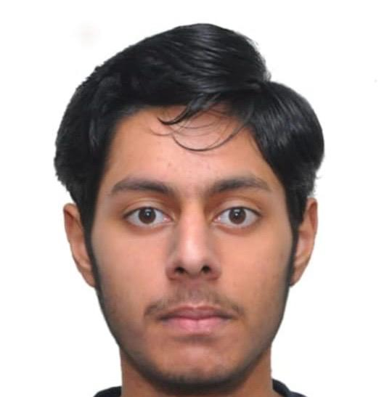
AbOUT ME
I am Khushkarman Singh Virk. I study in grade 11. I am 17 years old. I like tinkering with technology things. I am also interested specifically in cybersecurity and artificial intelligence.

Slide 5
About my internship journey with clevered
My internship journey with clevered has been amazing.
It helped me gain a new level of experience with ai and python.
Clevered instructor is in the main spotlight of this learning platform, they clear all your doubts and give you suggestions and advice in a very friendly and engaging way.
Home assignments and other things like app development toolkit and user mannual help in elevating the internship experience whole together.

Slide 6
About App
App's Introduction: Voice quiz generator app is a quiz app that uses speech recognisation as a method to get the answers and main focus is on the analysis of the questions answered correct or incorrect by the user.
Main Menu: the main menu of the app contains- question, options and the submit button.

Slide 7
How do I use the app
The app is used by simple clicks, question is displayed and pyttsx module transcribes the question. It speaks out the options. Please do wait for the module to complete speaking before answering or submitting the question.

Slide 8
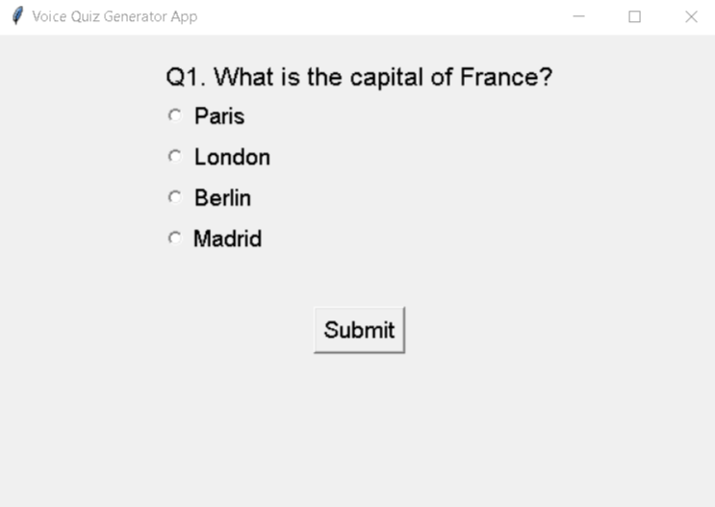
OPtion name
First option is question which displays the question from the file chosen for ex – beginner_data, intermediate_data, etc.
Second option are options displayed from dictionary stored in json files being created in back end.
Third option is of the submit button which moves to the next question when the current question is answered and shows result when all questions are answered.

Slide 9


Demo video

Slide 10
Toolkit walkthrough
Below are the links to the toolkit's documentation pages used in this project.
https://docs.google.com/spreadsheets/d/116Yg2A-hTAXOL4JRRckeTX_U7O5YH5Nd/r/edit/edit?gid=1219324219#gid=1219324219

Slide 11
Contact Person
Khushkarman Singh virk(me) can be reached through for any concerns/suggestions on the App:
Email: harmanprrtsingh1979@gmail.com

Slide 12
Thank you
By Khushkarman Singh Virk
harmanprrtsingh1979@gmail.com

